Slide 1
[DRAFT] A portal to (Meta)data
Dena Tahvildari - Bruna dos Santos Vieira
FAIR Data Team
Imaging Group Kick-off Health-RI, 30 August 2023

Slide 2
The Vision
To have a smart research infrastructure where users easily find resources and reuse them

Slide 3
Requirements
Describe resources according to international standards (rich enough and interoperable):
DCAT (EU Health Data Space > DCAT Health, DCAT AP for Portals)
And provide as much as possible semantic enriched metadata (unambiguous, machine-interpretable) for resources of interest
Notes:
To find stuff = We need to Describe stuff (be searchable before findable)
Findability = semantically enriched Metadata (unambiguous)

Slide 4
HRI Core Metadata Schema
Represent it in RDF Graph Model
Health-RI will supply a generic schema (Core) for resources to increase findability of such resources (e.g. datasets)
Nodes extend the core model for covering the specialised domain metadata requirements (Leaves)
Built Based on DCAT, DCAT-AP portals,
Represent it in RDF Graph Model

Slide 5
Proteo
NWO
The Sunflower 1.0
Metab
KWF
Transcrip
Omics
ZonMw
Funders
What Apart from DCAT AP Potals?
Core: Minimal DCAT AP Portals Extended: Health-RI
Leaves (Petals?): -Domain:Your Image daTA -sub-domains (MRI)
https://github.com/Health-RI/health-ri-metadata/
DCAT AP Portals
(mandatory fields)
Clinical
Biobank
0.9
2.0
CDEs
Cohorts
Rare Diseases
Image
PROMS
DCDEs

Slide 6
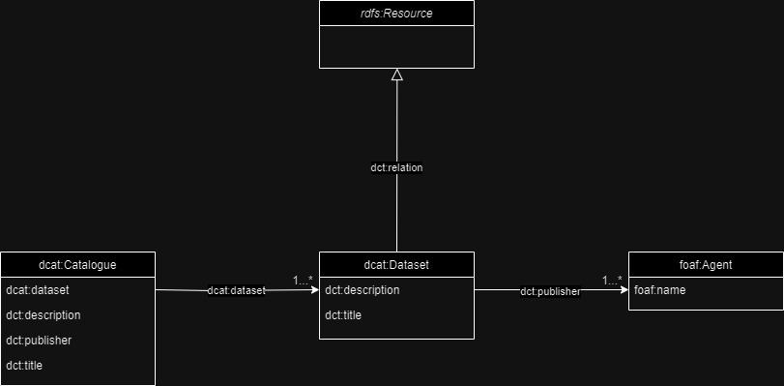
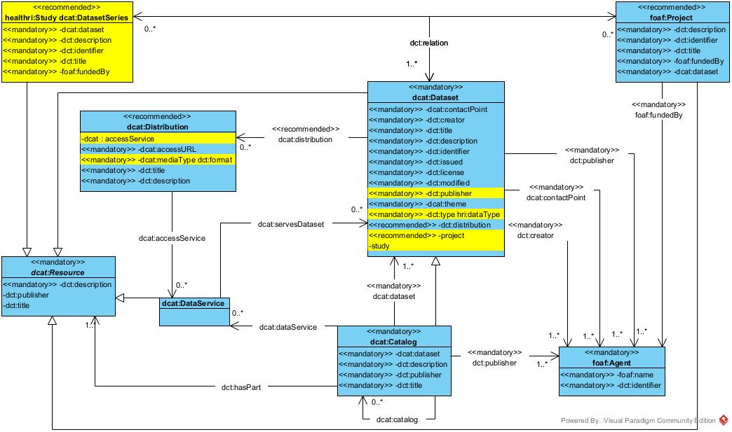
Health-RI core metadata schemas
All resources must describe provide the core metadata
Funders
Omics
What Apart from DCAT AP Potals?
DCAT AP Portals
(mandatory fields)
Clinical
Biobank
https://joinup.ec.europa.eu/collection/semic-support-centre/solution/dcat-application-profile-data-portals-europe
0.9
2.0
Rare Diseases
Cohorts
https://github.com/Health-RI/health-ri-metadata

Slide 7
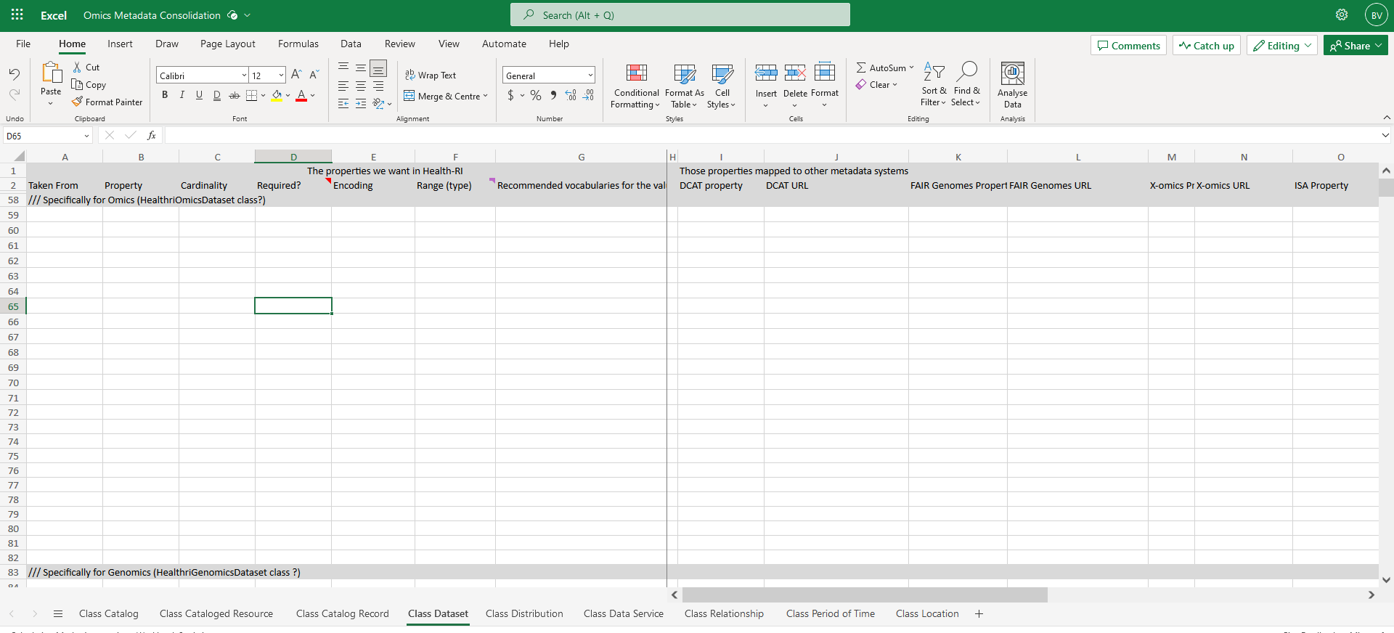
Health-RI domain (petal) metadata schemas
Funders
Omics
What Apart from DCAT AP Potals?
DCAT AP Portals
(mandatory fields)
Clinical
Biobank
0.9
2.0
Resources in a domain must offer, extra to the core, their minimal metadata to find their domain resources
Rare Diseases
Cohorts

Slide 8

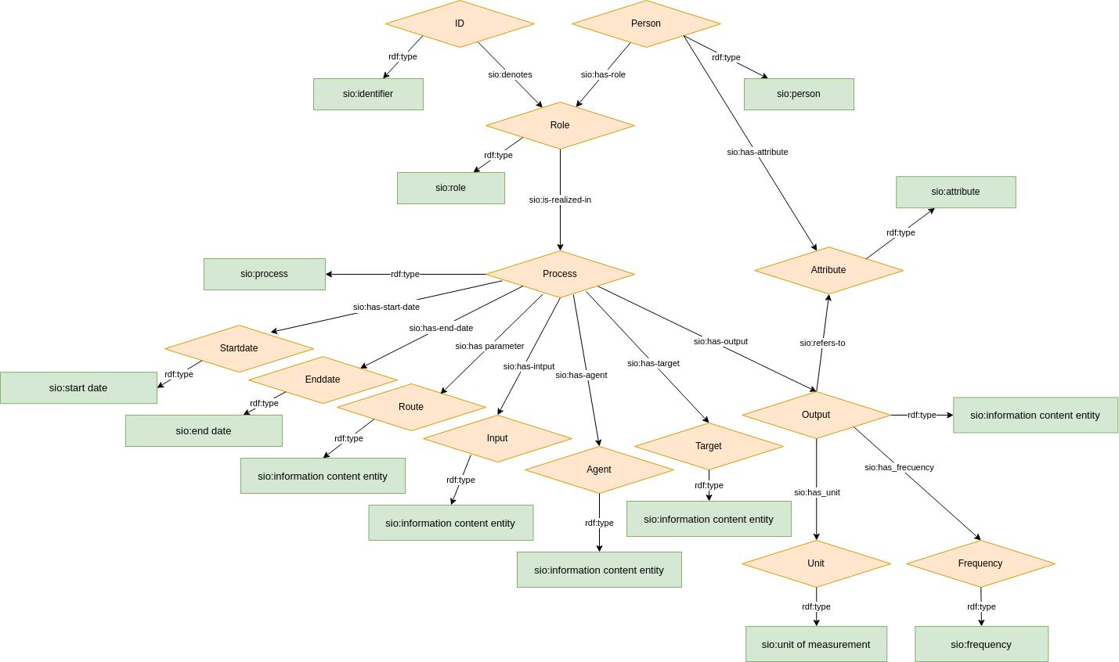
Health-RI data models
Omics
Funders
What Apart from DCAT AP Potals?
Variables, values, relations in a domain or project, example rare disease cde model, mldi, etc
DCAT AP Portals
(mandatory fields)
Clinical
Biobank
0.9
2.0
Cohorts
Rare Diseases
https://github.com/ejp-rd-vp/CDE-semantic-model

Slide 9
Metadata Schema Structure?
is a definition that provides organization to the metadata in the domain, represented in a formal language. In the rdf Graph Model, the metadata schema is known as an Ontology and it is represented in the RDF schema (RDFS) or OWL (Web Ontology Language) languages or other dialects (e.g SHACL).
Three main components are:
Classes: is an abstraction mechanism for creating a collection of objects with similar characteristics. The Objects call instances of a class. (e.g. Class(Dataset) and individual(dataset-100) is an instance of it). Class can have hierarchical relationships (subclass) which allows for inheritance and subsumption.
Datatype Property: these are relationships between instances of classes. (e.g. dataset’s title is a datatype property that related all the instance of the class dataset to a string datatype).
Object Property: These are relationships between instances of two classes. For example ”hasDistribution” is an object property that related all the instances of class dataset to instances of class distribution.

Slide 10
Metadata schema is a graph
metadata model
Dataset
Distribution
hasDistribution
rdf:type
rdf:type
CLASS
Dataset-100
hasDistribution
Distribution_X
instance
Instance
Relations

Slide 11
Namespace
To add

Slide 12

Team: HRI Core Metadata Schemas 🌻
Technical Metadata Team (TMT ) will support the technical part of building a metadata schema (Bruna, Dena, Luiz, Kees)
Only domain experts (working groups and portal teams) can define the metadata properties (content).
TMT add main properties from DCAT, DCAT AP portals, and supplied schemas from the nodes
Who will tell, apart from DCAT, which are the other obligatory fields?
Once domain schemas are out for review, TMT can check and embed the obligatory fields in the core schema
Portal groups will review taking into account usability, visuals etc

Slide 13
Defining Core – Generic metadata
Currently we have:
Identified EU standards (DCAT, DCAT AP Portals, DCAT AP Health)
Collected some NL Nodes and Health-RI metadata schemas (RUMC, AUMC, Princess Maxima, Covid Portal)
Mapped all of the above here
For HRI portal release 0.9:
Minimal Core: DCAT-AP Portals mandatory fields
For later (HRI portal release 2.0):
Plan to release HRI Core metadata schema answering: What apart from DCAT AP Portals mandatory fields should be in the HRI core?

Slide 14
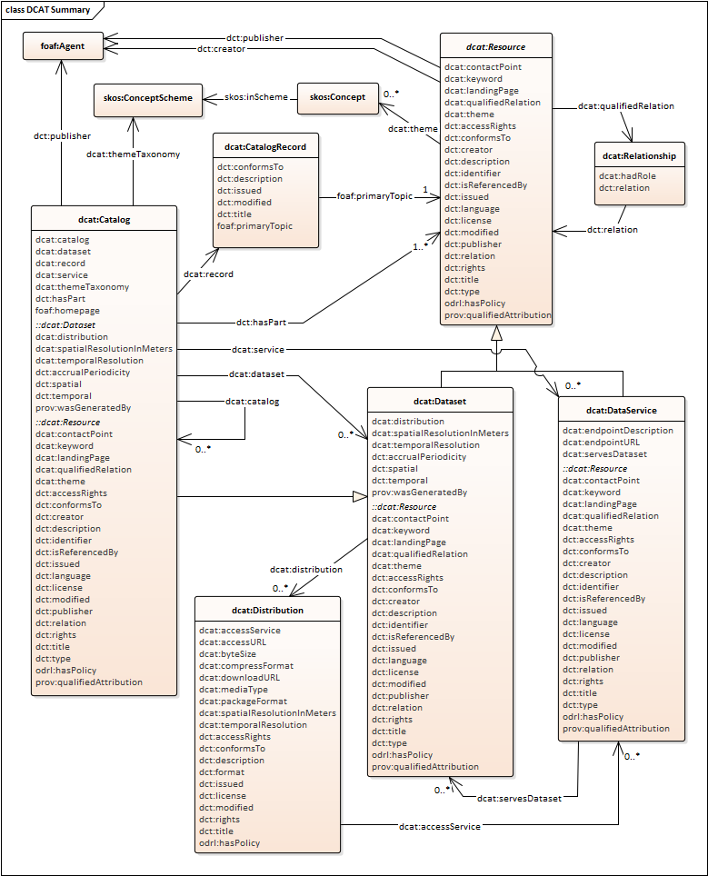
DCAT
Main classes:
dcat:Catalogue
Dataset
Distribution
And it borrows from:
foaf:Agent
skos:Concept, skos:ConceptScheme

Slide 15
DCAT
…and adds extra dataset-specific properties
DCAT Dataset class inherits :: properties of the resource super-class
Notes:
mostra dcat specifica + herdadas

Slide 16
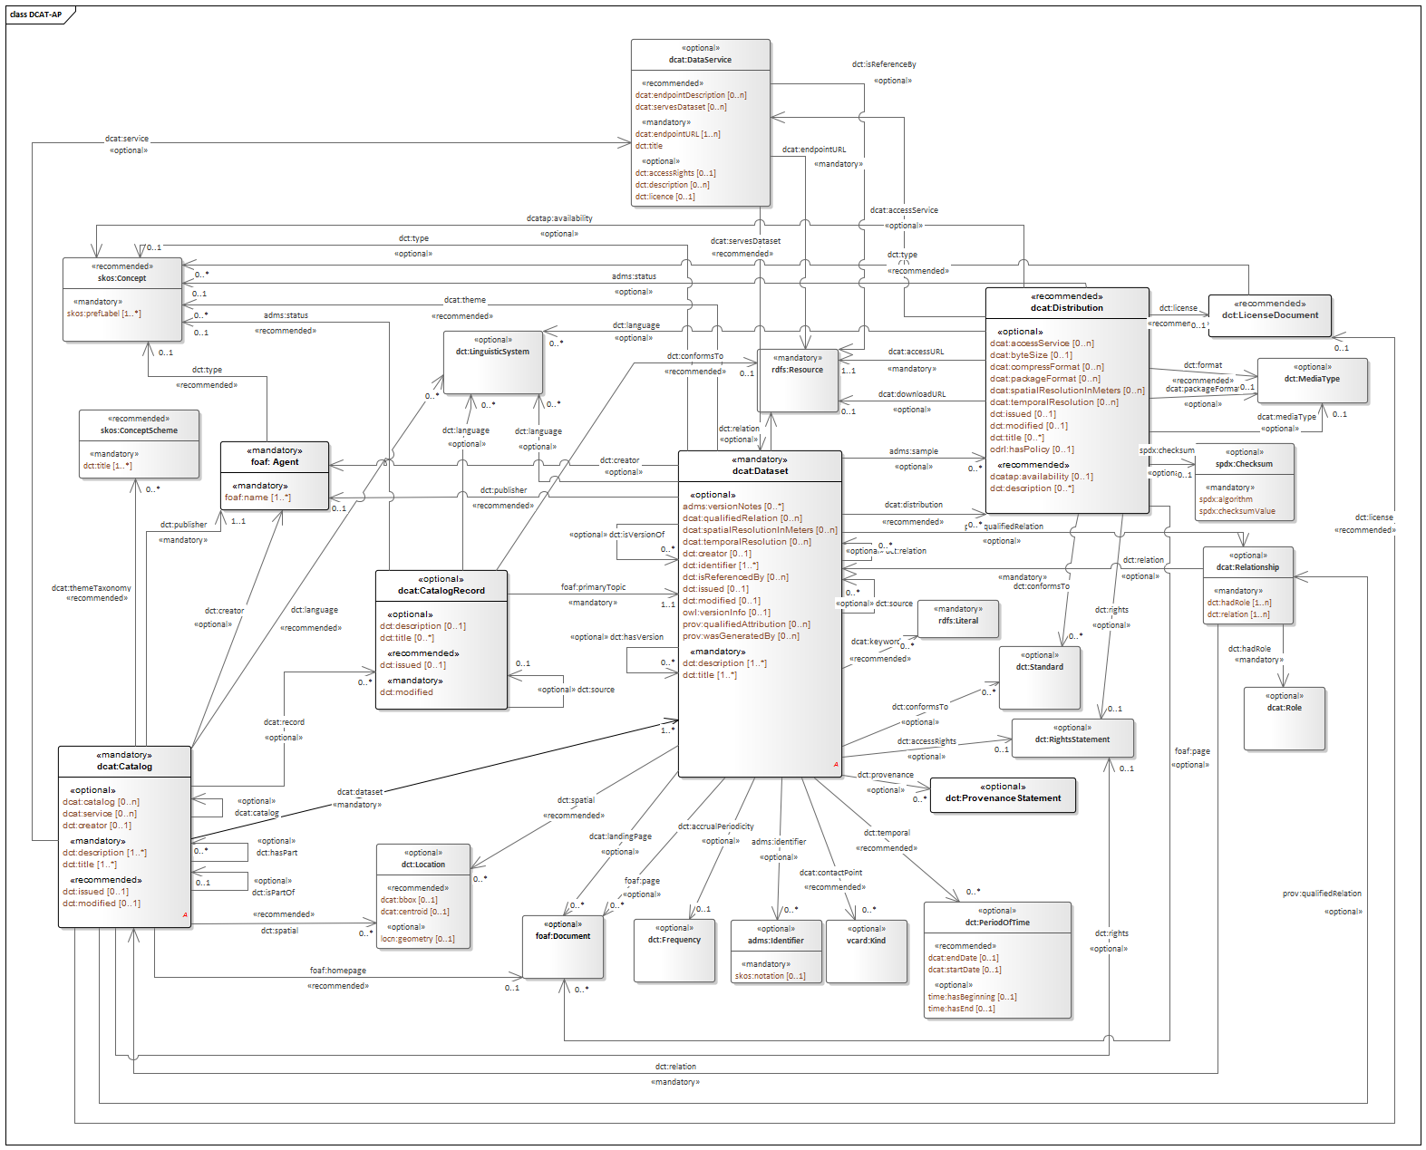
DCAT-AP Portal
Extension of DCAT
Defined mandatory fields for EU Portals

Slide 17
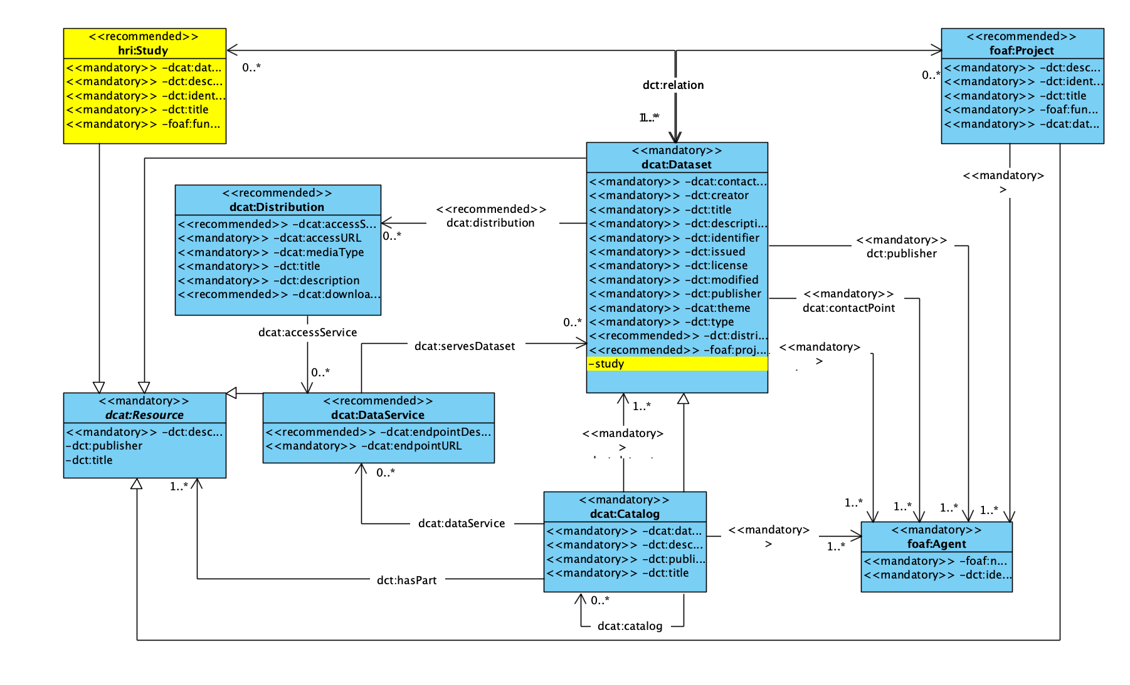
HRI Core schema 0.9 access on git

Slide 18
Defining Leaves – Specialized/domain Metadata
Domains (e.g. Image group) will specialize the generic schema into their needs and properties
Feedback / Result from Domain groups expected to be shared via Github
Request Rob 🧙 to add you to the HRI Metadata repo health-ri-metadata/Leaves/Image

Slide 19
Practical steps

Slide 20
1. Define a Scope What metadata should you prioritise
FAIR
Important to find your dataset (e.g. diagnosis, sample size, subjects (people, demo)
Increase accessibility (which protocol was used e.g. a form sent to the medical ethical committee)
Increase interoperability (which vocabulary, coding language was used in your data)
Increase reusability (consent/license, provenance, standards used for coding your data, study protocols as a quality standard, pointer to the data)
Other
Important for the “visuals” of the portal (e.g. Logo URL, Landing Page URL)
Important for your domain (e.g. imaging example)

Slide 21
Collect Requirements
Come up with the metadata requirements and document them in form of competency questions?
What is the temporal element of the image?
I want to be able to distinguish different images from each other based on the collection method?
Give me all the existing Data access levels, licensing?
Analyse the answer and make a spreadsheet and list all the important terms
Time, date created, data collection methods, patient-based, archives, ..
Try to group them, and add concrete definitions
Find their role in the schema (class, attribute, relations, controlled vocabulary, taxonomy)
Date → dataset attribute
For attribute define datatypes
Date → xsd:timedate
For each properties per class:
Vote for: → depending on the requirement
mandatory/ optional
cardinality
Identify non-technical items which may be important for portal (e.g. resource logo URL, resource landing page)
Results of voting will define the minimal schema for first release

Slide 22
Always Reuse -- Existing standards
Map your requirements to the existing standards and reuse the existing structure if applicable.
- DICOM® is the international standard to transmit, store, retrieve, print, process, and display medical imaging information”
From https://www.dicomstandard.org/, (Mildenberger et al, 2002)
- BIDS?

Slide 23
Map your first model to HRI core metatda model
Match source fields to destination fields
Semantic mapping
Wokring document https://docs.google.com/spreadsheets/d/1KKfAxn4ftoOAM2v3WsqT2XcPhdmTjnf1BZkvFf9FqF8/edit#gid=0
Push to HRI Git to be review
Next step: Implementation of the model and instantiation of the model with your data

Slide 24

Take away
Define requirements
Identify pre-existing standards in your field and map your requirements to it,
Request Rob (or Jeroen) for GitHub access
Model your requirement in graph model (class, properties , relations).
Map your model to the dcat model. Excel sheet
Keep your versioning in GitHub 🌻
Need specialised help? Talk to your group leaders 🧙
Need more Metadata/Modelling/FDP help? Talk to Luiz Bonino, Kees Burgers or Bruna Vieira, Dena Tahvildari
Want to offer help? Contact us!

Slide 25
Next step -- expose the medata model and metadata graph to the HRI portal
-- Implementation team help with the onboarding of your metadata elements and datasets to the portal

Slide 26
Acknowledgements
Julia
Kees
Luiz
Mijke
Marianne
Jeroen
Rita
Esther

Slide 27
Metadata Schemas and Portal Releases
Published HRI Core Metadata Schema (w obligatory fields of DCAT AP + what apart from DCAT-AP do we need?)
Published Domain Schemas (Leaves) (w obligatory fields per domain)
Documentation for users to follow on “how to describe their resource”
Releases
DCAT-AP Portals mandatory fields will be required for portal 0.9 release
HRI Core Metadata Schema (what apart from DCAT-AP do we need?) and leaves expected to be released for portal release 2.0

